Slide 1
ESC101: Fundamentals of Computing
Arrays as pointers
Nisheeth

Slide 2

Array of Pointers
Can use array of char pointers to store many (i.e., an array of) strings
An array of (say char) pointers can be created in two ways
- Use a static array declaration char *ptrArr[3]; and then initialize each of the 3 pointers ptrArr[0], ptrArr[1], and ptrArr[2] using malloc or as static arrays
- Use a dynamic array declaration as a pointer to pointers
char **ptrArr = (char **)malloc(3*sizeof(char *));
and then initialize each of the 3 pointers ptrArr[0], ptrArr[1], and ptrArr[2] using malloc or as static arrays
Just like name of array is a pointer
Name of array of pointers is also a pointer of pointer

Slide 3
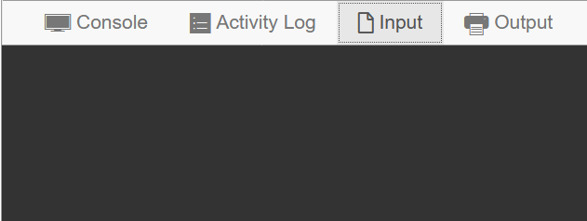
Array of Pointers ➔ Arrays of Arrays
char **ptrArr = (char**)malloc(3*sizeof(char*));
for(i = 0; i < 3; i++)
ptrArr[i] = (char*)malloc((i+1)*sizeof(char));
scanf("%c", &ptrArr[2][1]);
printf("%c", ptrArr[2][1]);
for(i = 0; i < 3; i++)
free(ptrArr[i]);
free(ptrArr);
X
ptrArr[0]
ptrArr[0][0]
ptrArr[1]
ptrArr[1][0]
ptrArr[1][1]
ptrArr
X
X
ptrArr[2]
ptrArr[2][0]
ptrArr[2][1]
ptrArr[2][2]

Slide 4
Accessing Elements in Array of Pointers/Arrays
Rest assured, the same rules apply as do with pointers
ptrArr[0], ptrArr[1], ptrArr[2] are all arrays of chars
How to access individual elements of these arrays?
Two ways to access index 2 element of str: str[2], *(str+2)
Apply exact same rule : ptrArr[2][2], *(ptrArr[2]+2) both give index 2 element of the array ptrArr[2]
Note that ptrArr[1] does not have 3 elements so ptrArr[1][2] may cause segfault!
char *ptrArr[3], str[3];
for(i = 0; i < 3; i++)
ptrArr[i] = (char*)malloc((i+1)*sizeof(char));

Slide 5
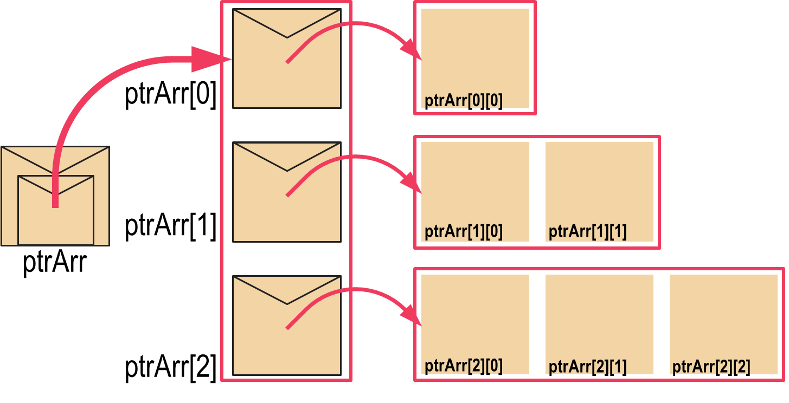



Accessing Elements in Array of Pointers/Arrays
Don’t write ptrArr++ illegal!
Even str++ illegal!
However, I can write char* qtr = str; qtr++; Now qtr points to str[1]
Rest assured, the same rules apply as do with pointers
You can show-off your skills by cool array access tricks ☺
Remember that str is a pointer to str[0]
In the same way, ptrArr is also a pointer to ptrArr[0] (which is an array)
str + 2 gives address of str[2]
ptrArr + 2 also gives address of ptrArr[2] (pointers take 8 bytes) – same rules!
We can access index 2 of the third array in many ways ptrArr[2][2],*(ptrArr[2] + 2),*(*(ptrArr + 2) + 2),(*(ptrArr+2))[2]
char *ptrArr[3], str[3];
for(i = 0; i < 3; i++)
ptrArr[i] = (char*)malloc((i+1)*sizeof(char));
I can also write char** rtr = ptrArr; rtr++; Now rtr points to ptrArr[1]
Don’t worry. we won’t ask exam questions on int (*ptr)[5];
I will ask questions on pointers to pointers, array of pointers, etc though
Just one potentially confusing notation in C
int *ptr[5]; is an array of 5 pointers to int but
int (*ptr)[5] is a single pointer to an array of 5 ints ☹
Notes:
Just remember that arr[i] and *(arr+i) mean the same thing in C, and all these indexing methods will make sense

Slide 6


2D Arrays: Revisited (Pointer’s view)
int mat[3][5]; // note: 2D array name mat is also a pointer to pointer (int ** )
Declares a matrix (2D array) with 3 rows 5 columns
Rows numbered 0, 1, 2. Columns numbered 0, 1, 2, 3, 4
Element at row-index i and column-index j is an int variable
Can access it using several ways mat[i][j],*(mat[i] + j),*(*(mat + i) + j),(*(mat + i))[j]
Careful! **(mat + i +j) ≠ *(*(mat + i) + j) ≠ *(*mat + i + j)
Not that much actually – let me show you the differences
This looks exactly like the way we access an array of pointers/arrays – what is the difference?

Slide 7
2D arrays vs Array of pointers
2D Arrays
Array of Pointers
Number of elements in each row is the same
All elements of 2D array are located contiguously in memory
Easier to initialize
Very convenient ☺
Different arrays can have different number of elements – more flexibility
Elements of a single array are contiguous but different arrays could be located far off in memory
Have to be initialized element by element
More power, responsibility
int mat[3][5] = { {1,2}, {3}, {4,5,6},{7,8,9,10,11},{-1,2,3,4}};

Slide 8
Memory layout of 2D arrays
000000
000001
000002
000003
000004
000005
000006
000007
000008
000009
000010
000011
000012
000013
000014
000015
000016
000017
000018
000019
000020
000021
000022
000023
…
char str[3][4] = {"Hi","Ok","Bye"};
str[0][0]
str[0][1]
str[0][2]
str[0][3]
str[1][0]
str[1][1]
str[1][2]
str[1][3]
str[2][0]
str[2][1]
str[2][2]
str[2][3]
H
i
\0
\0
O
k
\0
\0
B
y
e
\0
Location of the str pointer not shown
First all elements of row 0 stored in continuous sequence
Then without breaking sequence, all elements of row 1 stored and so on
char* ptr = *str; // ptr points to str[0][0]
ptr += 4; // ptr now points to str[1][0]
ptr += 4; // ptr now points to str[2][0]
ptr += 1; // ptr now points to str[2][1]

Slide 9
Layout of array of pointers
000000
000001
000002
000003
000004
000005
000006
000007
000008
000009
000010
000011
000012
000013
000014
000015
000016
000017
000018
000019
000020
000021
000022
000023
…
char **str = (char**)malloc(3*sizeof(char*));
str[0] = (char*)malloc(4*sizeof(char));
str[1] = (char*)malloc(4*sizeof(char));
str[2] = (char*)malloc(4*sizeof(char));
str
0 0 0 0 0 1 0 1
str[0]
str[1]
str[2]
0 0 0 0 1 0 0 1
0 0 0 0 1 1 1 1
0 0 0 1 0 1 1 0
str[0][0]
str[0][1]
str[0][2]
str[0][3]
Element within a single array always stored in sequence
Different arrays may be stored far away from each other
str[1][0]
str[1][1]
str[1][2]
str[1][3]
str[2][0]
str[2][1]
str[2][2]
str[2][3]

Slide 10
Summary
Arrays are just an application of pointers
In any dimensions, one can access arbitrary array elements with pointer math
Dynamically allocated arrays of pointers are a much more general data structure
Multidimensional arrays emerge as a special case
Other data structures also emerge as special cases, as we will see when we discuss structures
Whenever you get a problem where the size of the input arrays are not fixed, you have to use dynamic allocation
Notes:
Practice array definition and initialization in both static and dynamic forms within the same program over and over again. That way, the connection between the two representations will become clear.

